Slide 1
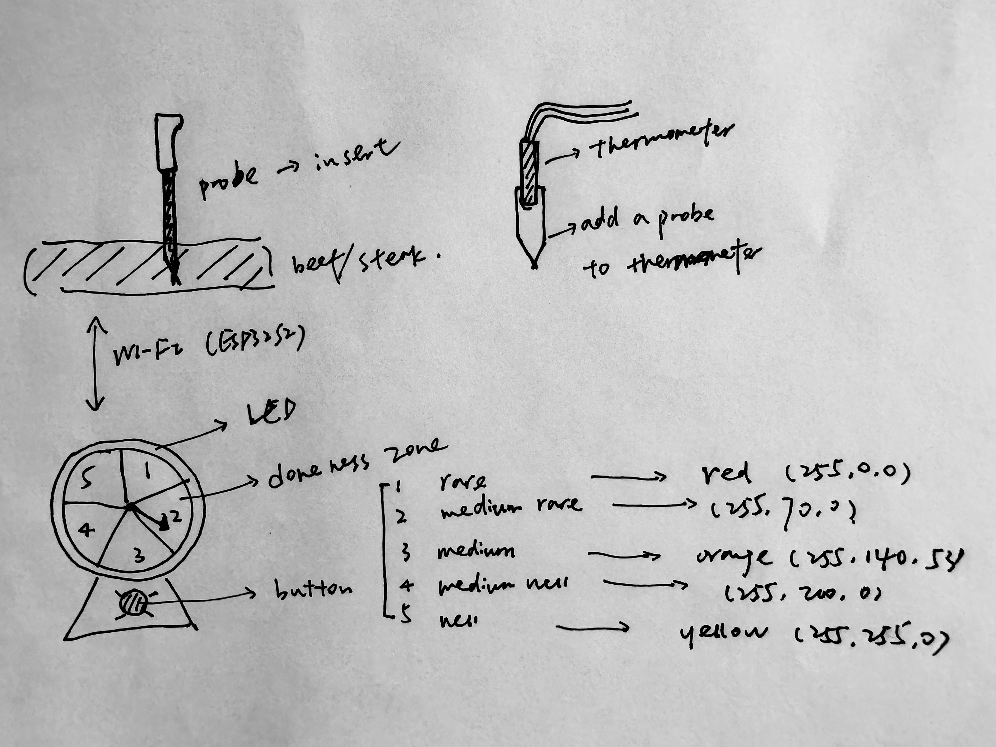
TECHIN 514 Final Project
Ruiqing Wang 2222338
The probe can measure the internal temperature of the steak, thus obtaining the doneness of the steak and displaying it on the dashboard. The RGB LED can be turned on by the button, and its color will change according to the maturity.
Steak Doneness Measuring Device
Notes:
Led显示熟度 自动亮起
Needle显示倒计时 315度 重新划分区域
根据现在的温度预估成熟的时间，用算法，显示在仪表盘上，预估到每一个不同状态的时间
Button 改成用来reset/turn on&off
I will add a timer function, using the current temperature and algorithm to predict the amount of time it needs to reach each doneness and show by the stepper-motor-driven gauge needle. Also, the needle angle range is 315 degrees, instead of 360 degrees, so I need to reassign the zones. Finally, I will change the function of the button from turning on and off the LED to turning on and off the whole sensing device.

Slide 2
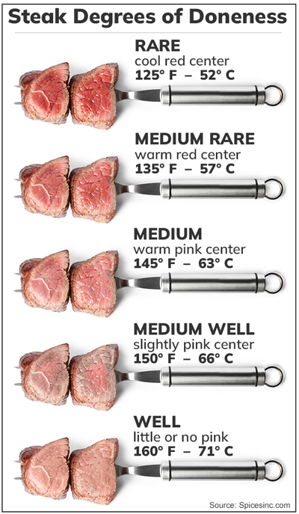
Sensing Device
Seeed Studio XIAO ESP32S3 & 5V Lithium battery
Temperature probe:
DS18B20 Programmable Resolution 1-Wire Digital Thermometer
Wiring: Red(VCC), Yellow(Data), Black(GND)
Temperature range: -55 ℃ ~ +125 ℃
Power supply: 3.0V ~ 5.5V
( a 4.7K resistor between the Data and VCC)

Slide 3
Display Device
Seeed Studio XIAO ESP32S3 & 5V Lithium battery
(https://www.seeedstudio.com/XIAO-ESP32S3-p-5627.html)
A stepper-motor-driven gauge needle: X27.168
This has extremely fine step precision of about 1/2 a degree per step, 600 steps for single stepping, fast response for quick movements, and a range of ~315° degrees. (https://www.adafruit.com/product/2424)
LED: NeoPixel RGB
Full 24-bit color ability with PWM taken care of by the controller chip. (https://www.adafruit.com/product/1312)
Button: B3F Tactile Button switch (https://www.adafruit.com/product/367)

Slide 4
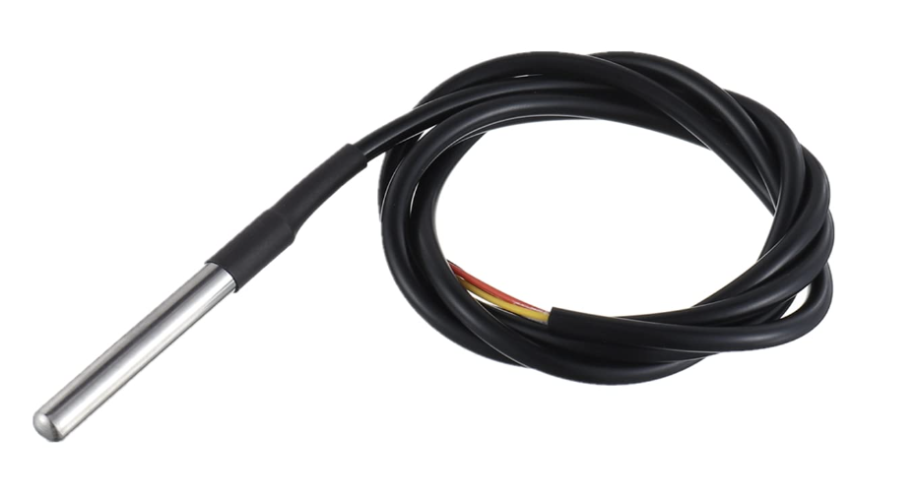
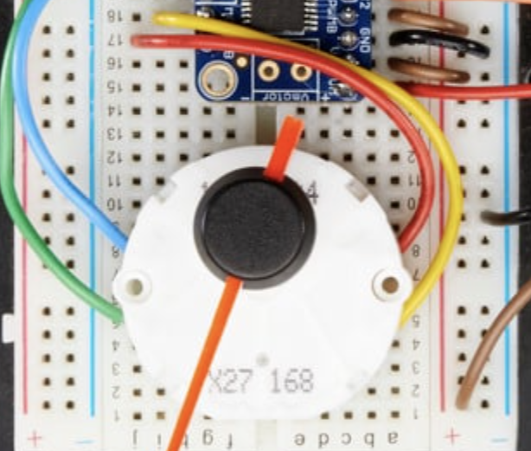
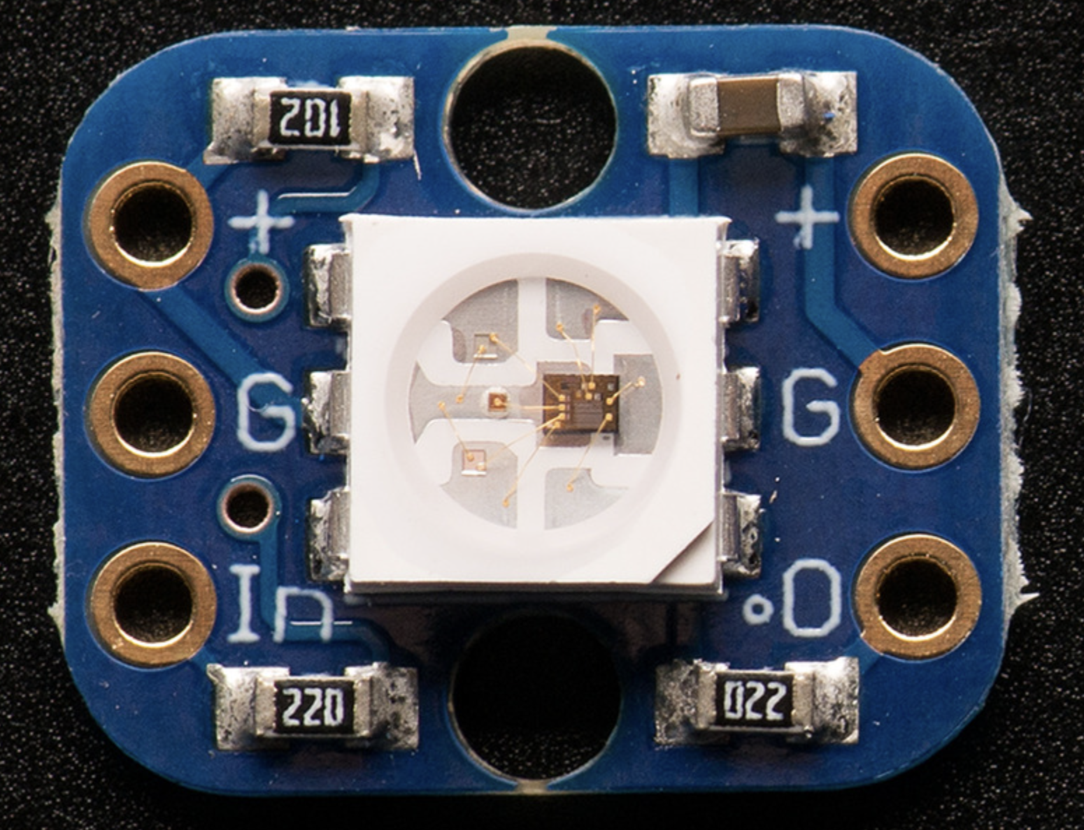
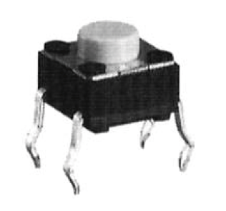
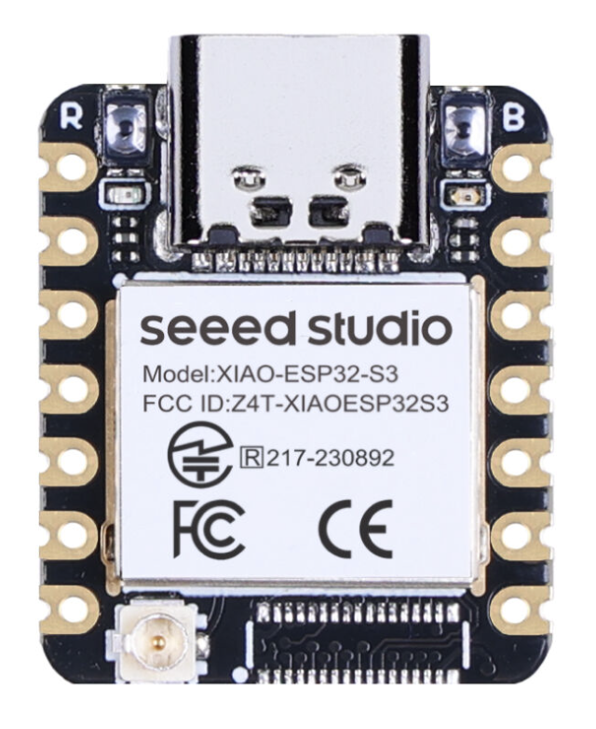
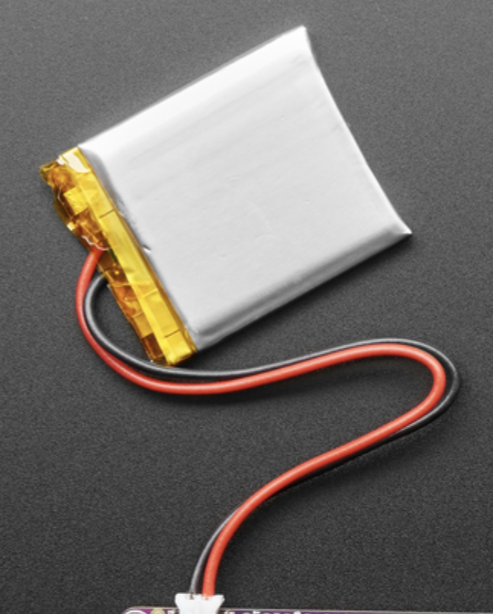
Communication & Work Flow
Input
Output
Temp Detect
ESP32
WI-FI & Signal Processing
ESP32
Needle
If Off
Button
If On
If rare: RGB LED-red
If medium: RGB LED-Orange
If well: REB LED-yellow
WI-FI &
Signal Processing

